Slide 1
Brand new day: Electricity consumption of Selangor’s industrial sector
ECLIPSE
Real-World Capstone Project Tracks – TRACK 1: SMART GRID ENERGY DEMAND
Athirah
Amalina
Fakhriah

Slide 2


challenge
Why does this problem matter?
Industrial electricity demand changes every hour: Factory operations, production schedules, and weekend activity.
Inaccurate forecasts lead to: Over-generation, wasted reserve capacity, higher operational costs, and reduced grid effciency.

Slide 3
AIMS
Develop a 24-hour ahead forecasting model to accurately predict Selangor’s hourly industrial electricity consumption for smart grid operational planning.
THE IMPORTANCE
Largest industrial state
Supports sustainability
High electricity demand
Business value: Reduce peak demand cost

Slide 4
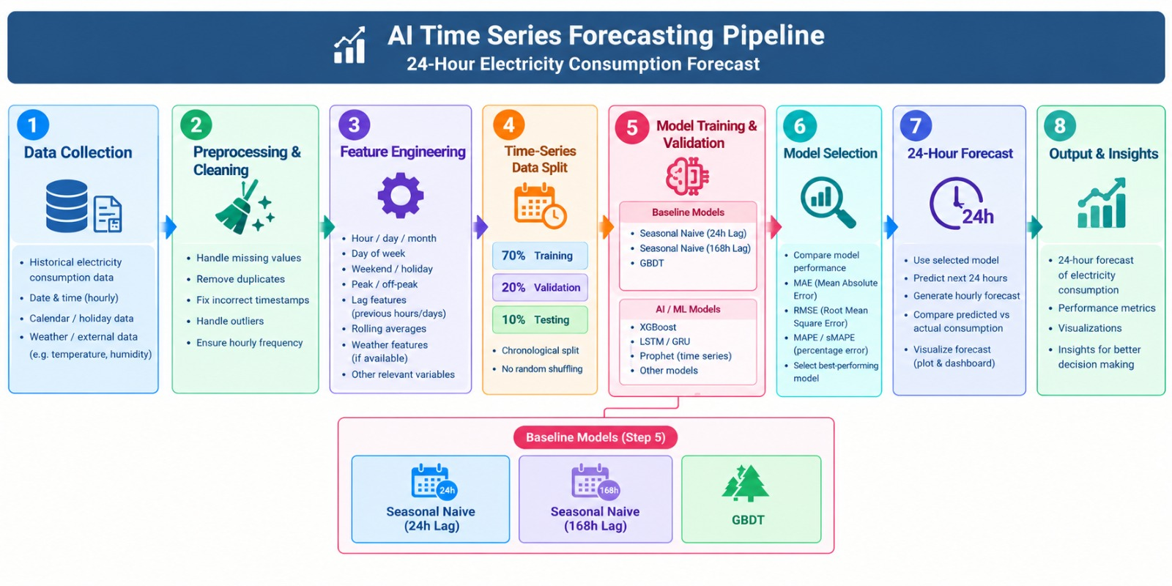
PIPELINE

Slide 5
Data preparation & hygiene
TRAINING DATASET
FEATURES USED
PERIOD: January 2025 – December 2025 | Hour
FREQUENCY: Hourly | Day of week
TOTAL RECORDS: 3,760 | Weekend Indicator
SECTOR: Industrial | Temperature Humidity
Source: MYEnergyStats

Slide 6
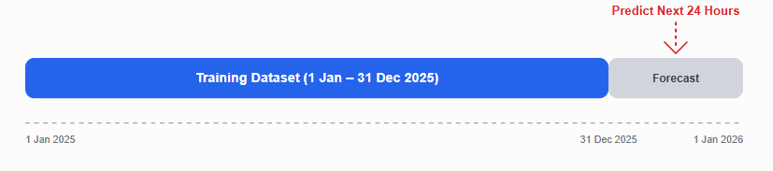
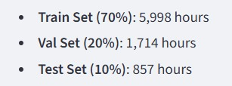
LEAKAGE-FREE VALIDATION
TEST DATA

Slide 7
Model tournament VS
BASELINE
SEASONAL NAIVE | GBDT
Uses the previous day’s (or previous week’s) hourly demand as the prediction. | Learns nonlinear relationships between time, weather, and historical consumption.
Simple, transparent, and serves as the benchmark model. | Expected to achieve lower MAE and RMSE than the baseline.

Slide 8
Operational decision framework
gbdt FORECAST
THRESHOLD RULES
SAFETY BUFFER
GRID DISPATCH
FORECAST (KMWh) | RISK LEVEL | GRID ACTION
<1,100 | LOW | Normal Operation
1,100 – 1,300 | MODERATE | Monitor industrial load
1,300 – 1,500 | HIGH | Prepare reserve generators
≥ 1,500 | CRITICAL | Dispatch reserve & demand response

Slide 9
Operational decision framework
FROM 1 JANUARY 2026:
HOUR | GBDT FORECAST | DECISION
01:00 | 1,004.55 | Normal operation
06:00 | 1,193.05 | Monitor
15:00 | 1,560.7 | Dispatch reserve & demand response
21:00 | 1,305.7 | High Demand

Slide 10
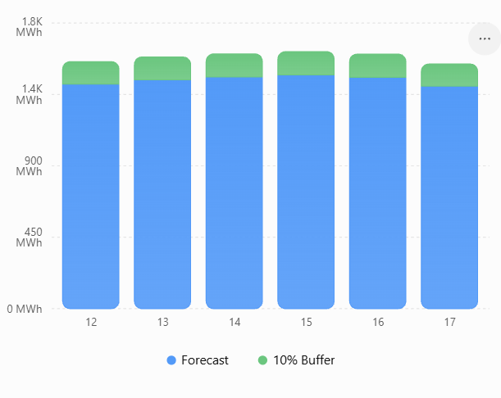
Operational decision framework
GBDT FORECAST
THRESHOLD RULES
SAFETY BUFFER
GRID DISPATCH
10% Reserve Capacity Planning
To improve grid reliability, a 10% safety buffer is added during peak industrial hours
Forecast peak: 1,695.66 KMWh
10% Safety Buffer: 59.61 MWh
Required Capacity: 1,755.27 MWh

Slide 11
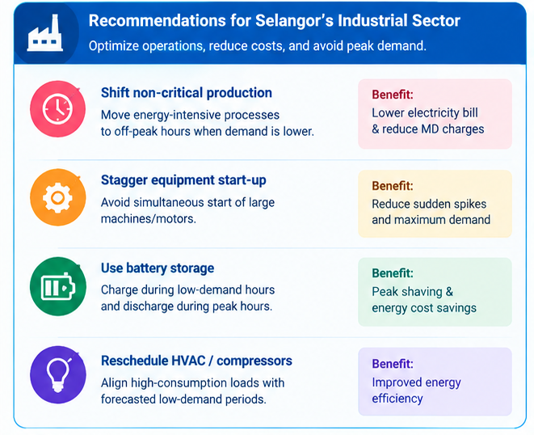
RECOMMENDATIONS

Slide 12

Q & A
Panel discussion session

